Slide 1

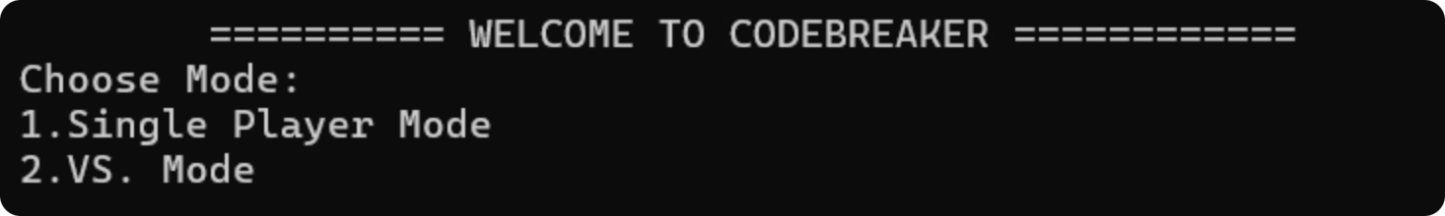
CODEBREAKER|
A Simple Number Guessing Game
Presented By:
Zuha Azhar CT-25055
M. Ashar Hussain CT-25087
BINARY BREAKERS
Section B-CSIT

Slide 2

Table Of Contents
Intro
Key Features & Objectives
Why Build CODEBREAKER
Game Overview
Feedback System
Control Flow of Menu
Single Player Mode Title & Intro
Single Player Implementation Breakdown
Single Player Flowchart
VS Mode Title & Intro
VS Mode Implementation Breakdown
VS Mode Flowchart
Console Based Examples
Architecture Diagram
Challenges & Solutions
Conclusion

Slide 3

What is CODEBREAKER?
CODEBREAKER is a logical and engaging Number Guessing Game built in C language, designed to test intuition, deduction, and quick thinking.

Slide 4




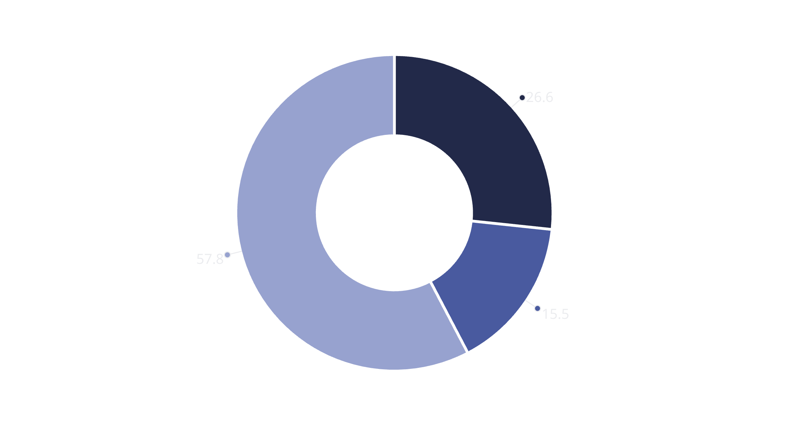
Key Features & Objectives
The primary objective was to create a fully functional console-based game using core programming fundamentals.
Console-Based
Single Player Mode
Built entirely using core C programming fundamentals.
Allows users to select difficulty (3, 4, or 5 digits) with
limited attempts.
VS. Mode
Strategic Hints
Head-to-head competition with separate secret
codes and time tracking.
Provides feedback after each guess to guide the player.
Core Focus
Gameplay
Emphasizes real-time interaction, modular coding, and the practical use of loops, conditionals, and random number generation.
Players guess a randomly generated secret number within limited attempts, guided by hints after each guess.
Functions
Conditionals
Iteratives

Slide 5










Why Build CODEBREAKER?
Real Code
Apply fundamental C concepts in a complete, working project
Logical Thinking
Develop deductive reasoning through systematic guessing
Engaging Gameplay
Create something fun while mastering programming essentials
Modular Design
Build organized, reusable code functions and structures
Vs. Potential
Expand your skills with competitive, interactive features

Slide 6

Game Overview: Modes and Feedback
The game prompts the user to choose between Single Player and VS. mode.
Single Player Mode
VS. Mode
Select difficulty (Easy: 3 digits, Medium: 4 digits, Hard: 5 digits).
Two players compete head-to-head with unique 4-digit secret numbers.
Player has five attempts to guess the secret code.
Completion times are recorded for each player.
Score starts at 115 and depletes by 15 per wrong attempt.
The player who guesses correctly in the least time wins.
This game highlights the use of loops, time functions, and string handling for accurate timing and fair play.

Slide 7



The Feedback System
After each guess, you'll receive symbols that reveal how close you are to cracking the code. Learn to decode these hints strategically to narrow your possibilities.
#
~
X
Correct digit in correct position
Correct digit in wrong position
Digit does not exist in code

Slide 8
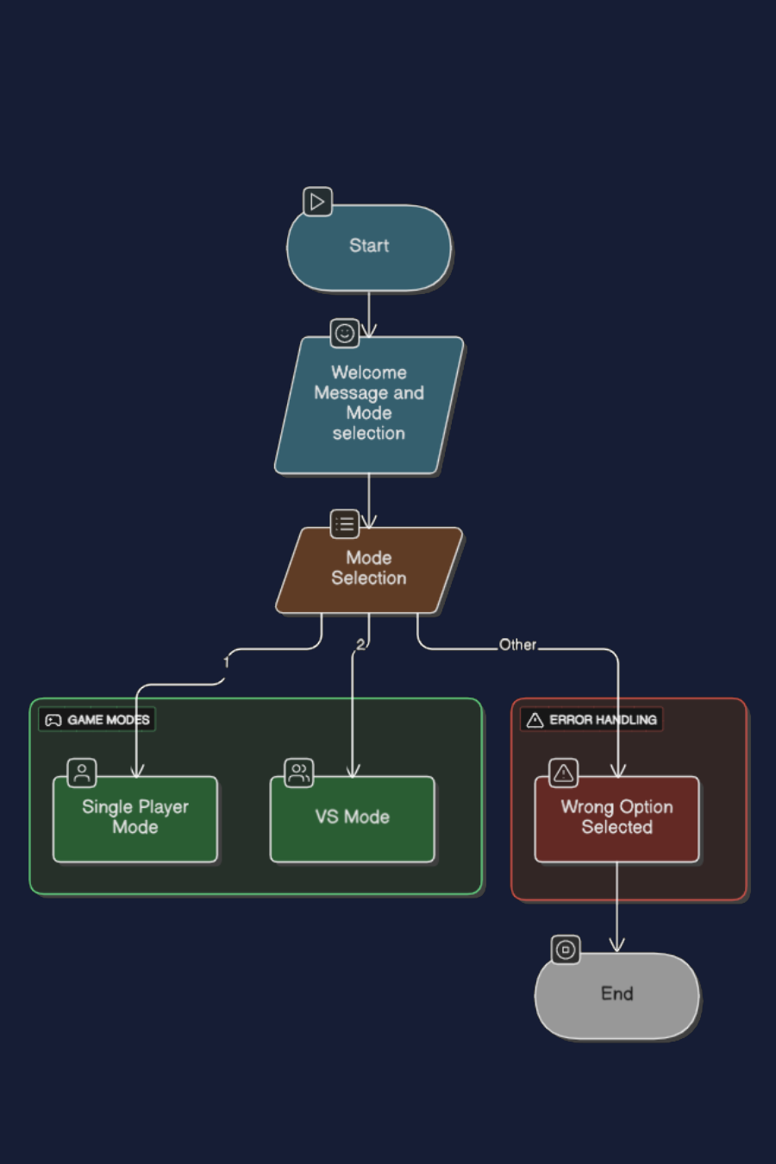
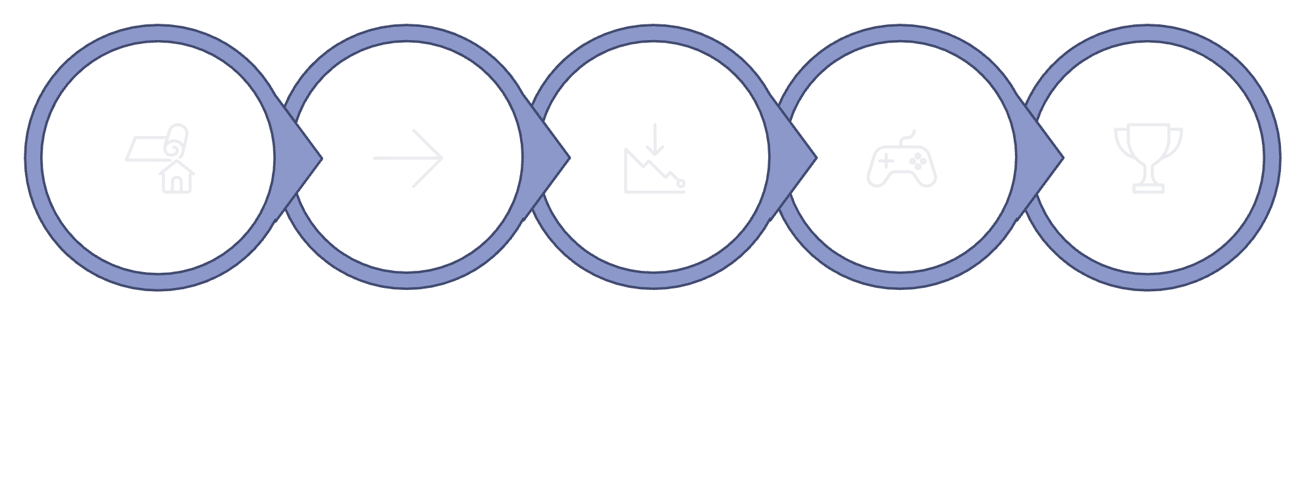
Flowchart and Control Flow
of Menu
The flowchart outlines the complete logic and progression of the CODEBREAKER game, from start to finish.
Welcome
Mode Select
Setup
Gameplay Loop
Results
The logic includes setup steps like random number generation, timer initialization, and input handling, ensuring a structured execution flow.

Slide 9

Single Player Mode
Choose Your Challenge
Easy
1
3-digit code. Perfect for beginners learning the game mechanics and building confidence.
Medium
2
4-digit code. Balanced difficulty for intermediate players seeking a competitive challenge.
Hard
3
5-digit code. Expert-level gameplay for experienced players testing their deduction skills.

Slide 10
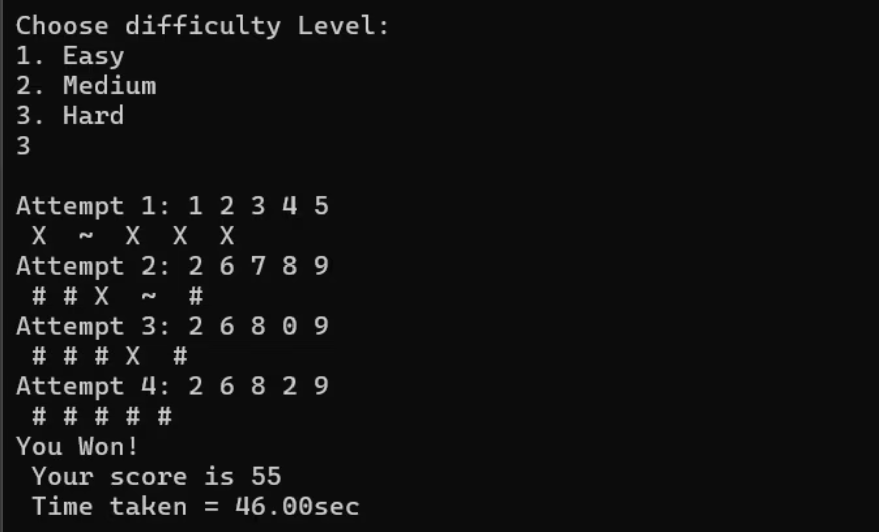
Implementation Breakdown: Single Player
The Single Player mode relies on core C functions for code generation, comparison, and scoring.
Secret Code Generation
Guess Comparison
Scoring & Timing
Uses rand() and srand(time(0)) to create secret numbers based on difficulty level.
Each player guess is compared digit-by-digit to the secret code to provide feedback.
Score depletes with wrong attempts. Time is tracked using time_t variables.

Slide 11
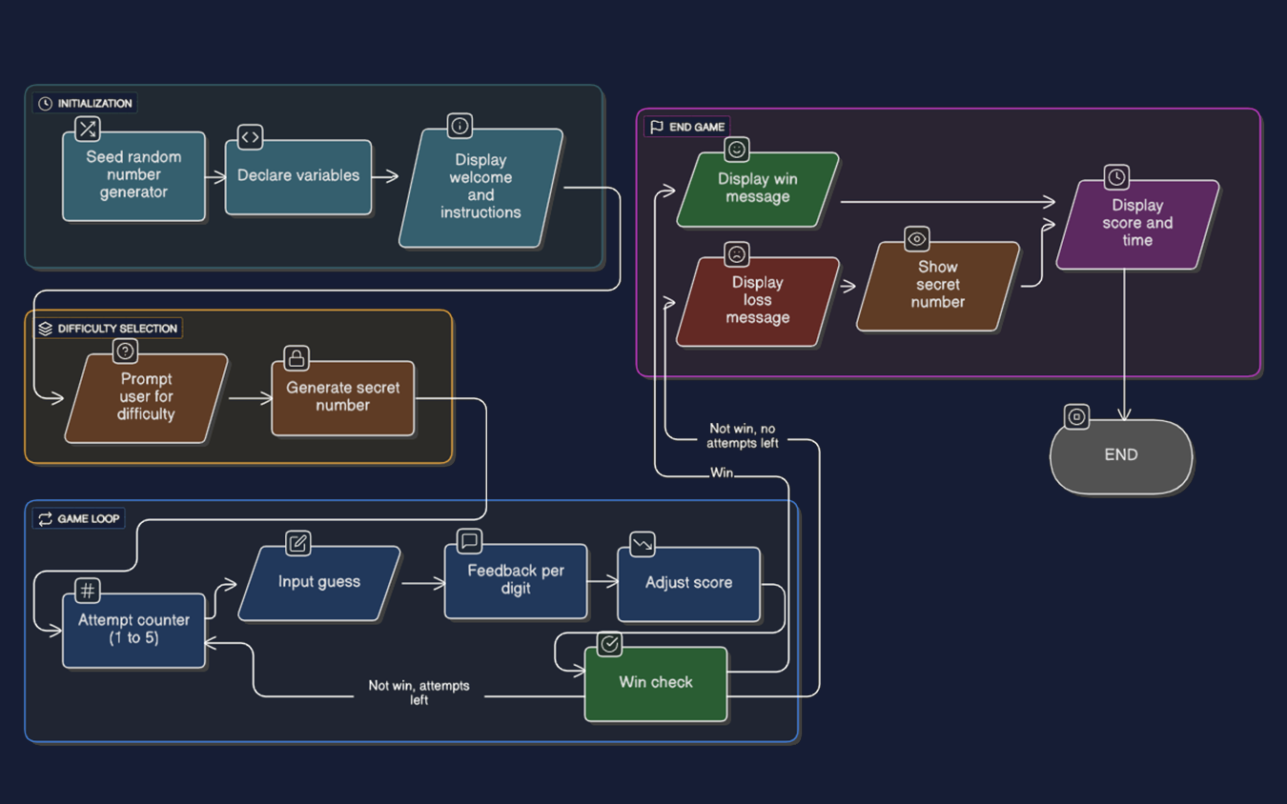
Flowchart of Single Player Mode

Slide 12

VS. Mode
Faster One Wins!
Competitive
1
Two players compete head-to-head with unique 4-digit secret numbers.
2
Timed
Completion times are recorded for each player.
Quick
3
The player who guesses correctly in the least time wins.

Slide 13
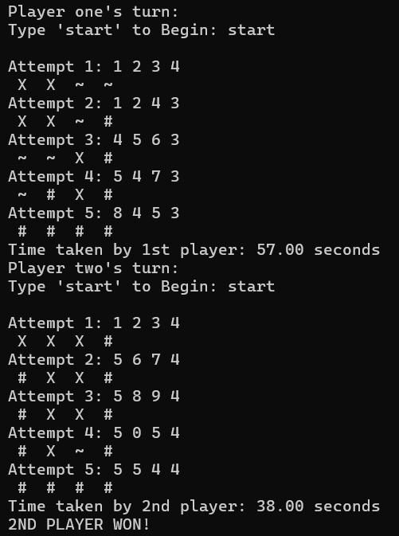

Implementation Breakdown: VS. Mode
The VS. Mode introduces competition by tracking and comparing the completion times of two players.
Secret Code Generation
Player 1 and Player 2 are assigned unique 4-digit secret numbers.
Timer Working
Players type 'start' to initiate their turn and begin time tracking (time(&start)).
Scoring & Timing
The program tracks time until the player correctly identifies all four digits (time(&end)).
Win Condition
The winner is determined by the player with the lesser completion time.

Slide 14
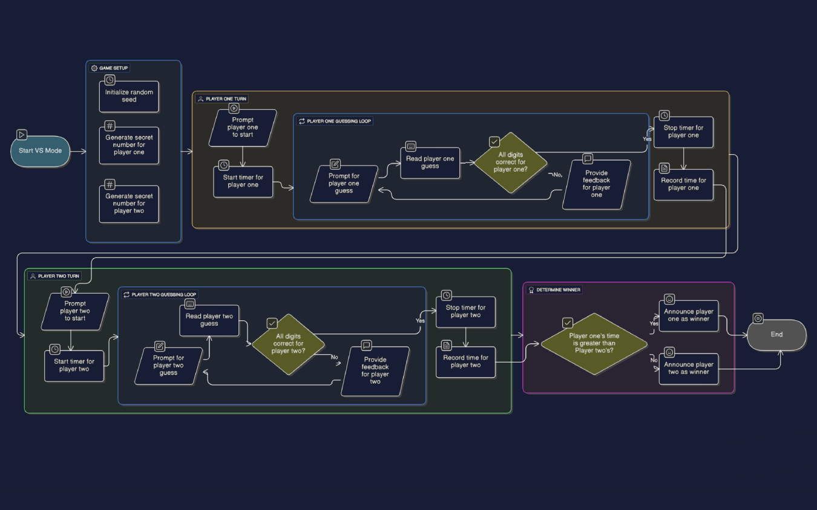
Flowchart of VS. Mode

Slide 15
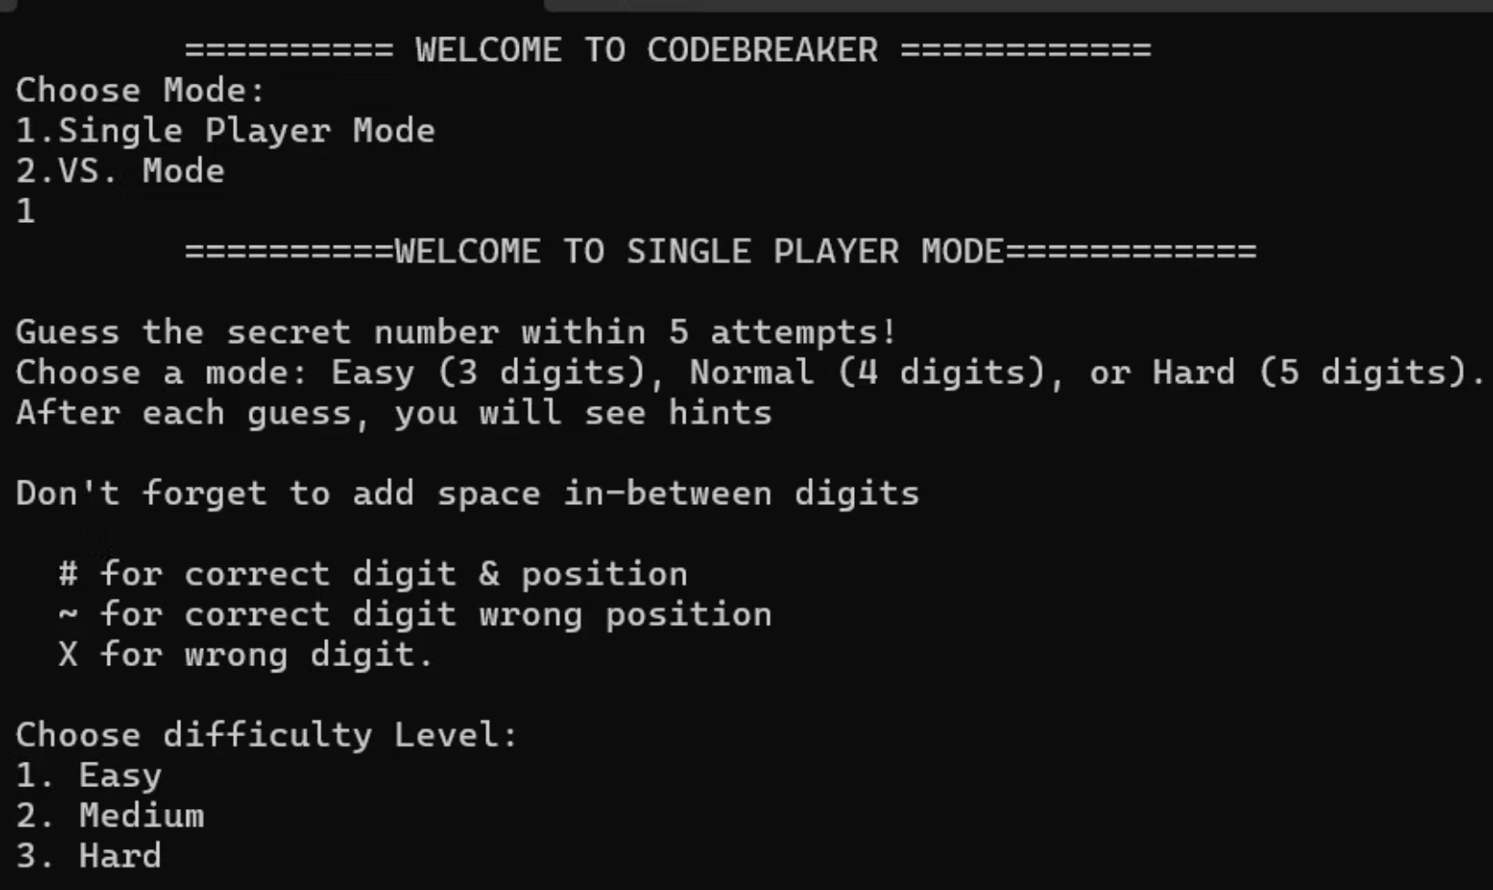
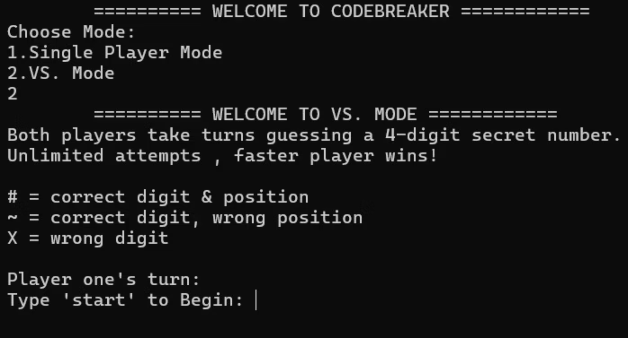
Console Based Examples
Single Player Mode
VS. Mode

Slide 16
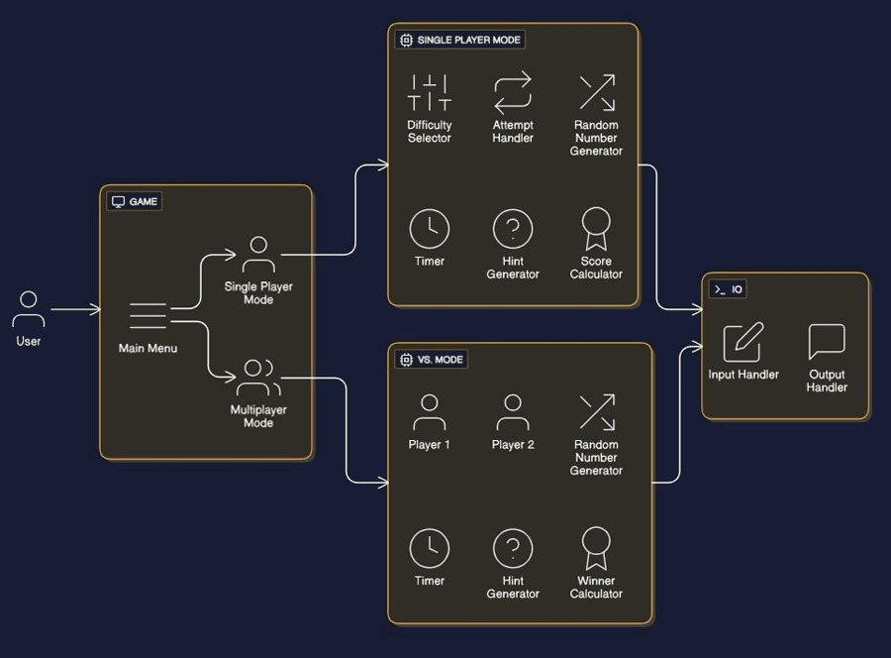
Architecture Diagram: Program Structure
The modular structure of CODEBREAKER reinforces the importance of well-organized code.

Slide 17

Challenges & Solutions in Development
Several technical challenges were addressed to improve performance and user experience during development.
Input Overlap
Fixed by properly separating integer and string inputs from multiple scanf() calls.
Random Repetition
Resolved by seeding srand() only once per mode for better randomness.
Timing Issues
Corrected multiplayer timer to start only after the player's input, ensuring accuracy.
Scoring & Formatting
Standardized scoring across difficulties and refined output formatting for clearer feedback.
Did You Know: CODEBREAKER uses both random number generation and real-time timers to create a fair, competitive experience for players.

Slide 18
Conclusion & Future Outlook
The CODEBREAKER project successfully demonstrates the application of fundamental programming principles in an entertaining and educational application.
Goals Achieved
Thank
You!
Combined core programming concepts with teamwork, creativity, and strong problem-solving skills.
Future Improvements
Potential enhancements include adding a GUI, sound effects, and adaptive difficulty for greater engagement.

